Slide 1

Building an Impactful Power BI Sales Dashboard
Unlock the power of data visualization to drive sales performance. This presentation guides you through creating an effective Power BI sales dashboard that transforms raw data into actionable insights.

Slide 2

Why a Sales Dashboard Matters: Unlocking Performance Insights
A sales dashboard consolidates complex data into clear visuals, providing real-time insights that fuel decision making. It helps track trends, identify top performers, and uncover opportunities or challenges early. With a comprehensive sales dashboard, businesses can optimize strategies, boost efficiency, and align teams toward revenue goals.
By highlighting key metrics and comparing performance across products, regions, and time periods, dashboards empower stakeholders to react swiftly and intelligently.

Slide 3
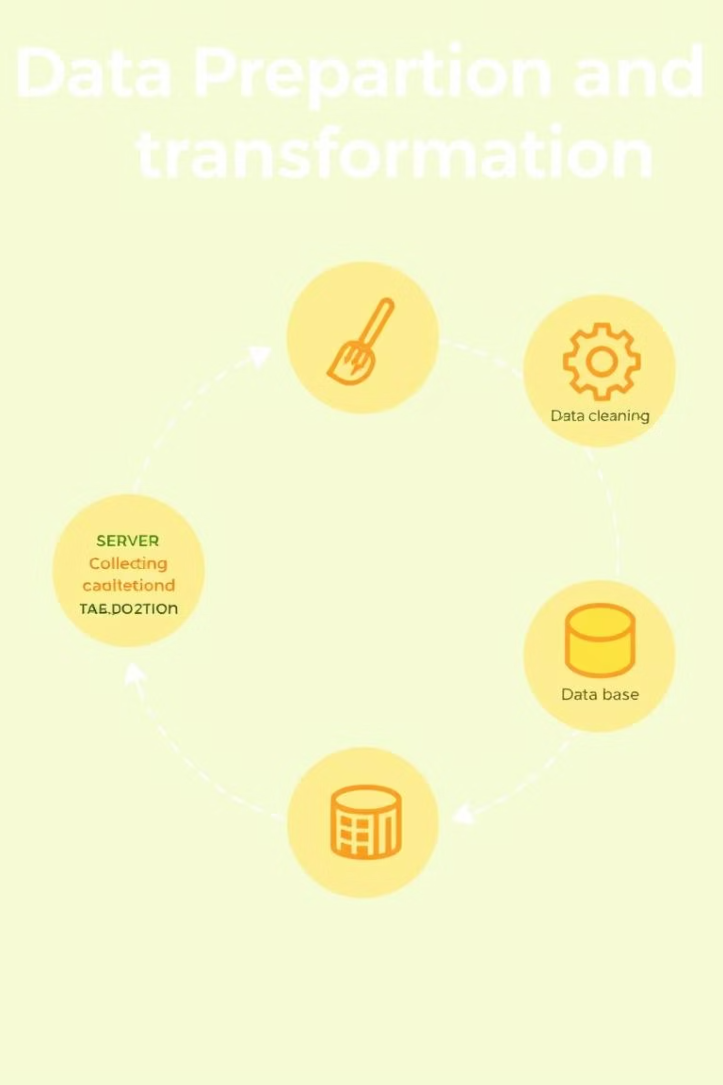
Data Foundation: Sourcing, Cleaning, and Transforming Sales Data
The backbone of any effective sales dashboard is reliable data. This includes integrating data from CRM systems, ERP platforms, and e-commerce databases. Data cleaning is crucial to correct errors, handle missing values, and ensure consistency across sources.
Transformations such as aggregations, currency conversion, and date hierarchy creation prepare data for meaningful visualization. Power BI's Power Query Editor simplifies these processes with intuitive, automated tools.

Slide 4





Defining Key Performance Indicators (KPIs) for Sales Success
Total Sales Revenue
Overall income generated from sales activities, essential for tracking growth.
Sales Growth Rate
Measures percentage increase in sales over time to evaluate momentum.
Average Order Value
Indicates the average amount spent per transaction, helping to identify upsell opportunities.
Customer Acquisition
Tracks the number of new customers acquired, reflecting market expansion efforts.

Slide 5
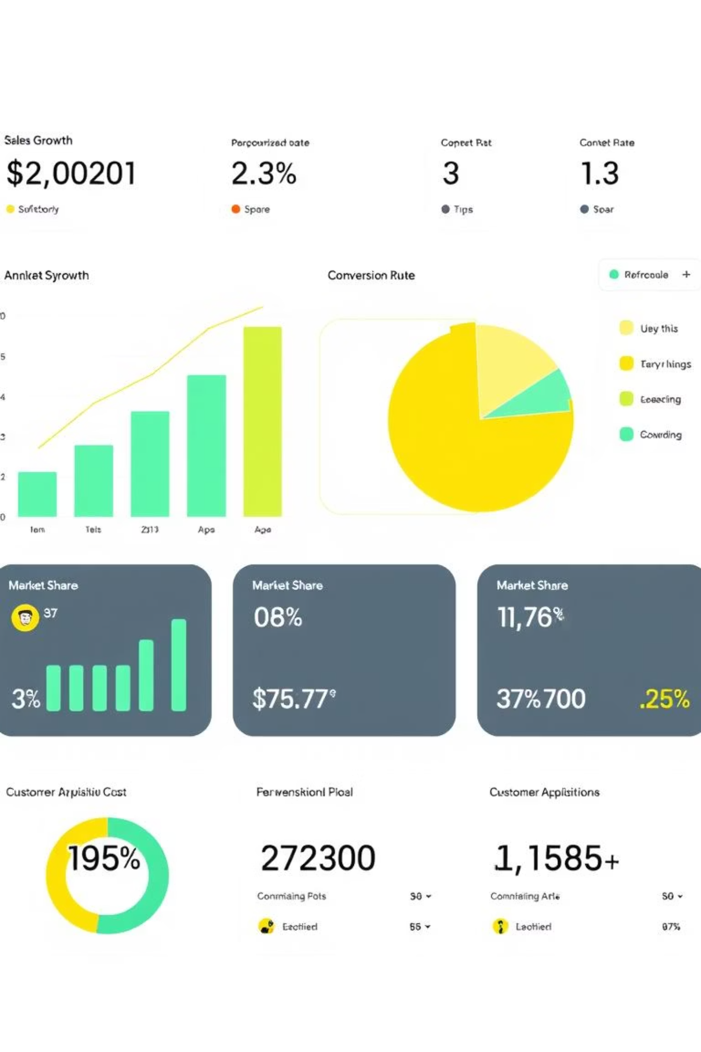
Dashboard Design Principles: Visualizing Data for Clarity
Effective dashboard design balances aesthetics with functionality. Use clean layouts with logical grouping to reduce cognitive load. Choose chart types that best represent your data — line charts for trends, bar charts for comparisons, and KPI cards for quick highlights.
Employ consistent color coding to differentiate categories without overwhelming viewers, and prioritize key insights at the top or in prominent positions.

Slide 6
Crafting Your Dashboard: Practical Steps in Power BI
Connect your data sources and use Power Query to shape data effectively.
Create calculated columns and measures with DAX to enrich your dataset.
Design visuals: select charts, slicers, and KPI indicators aligned to your KPIs.
Arrange elements in a coherent layout emphasizing ease of interpretation.
Set filters and bookmarks to customize views for different users or regions.

Slide 7

Enhancing User Experience: Interactivity and Drill-Through
Power BI offers interactive features like slicers, tooltips, and drill-throughs to deepen user engagement. Slicers allow filtering by criteria like date or region. Drill-through pages let users explore detailed data behind summary metrics.
Tooltips provide contextual info on hover, guiding users without cluttering the main display. These features make your dashboard dynamic and adaptable to diverse analytical needs.

Slide 8



Key Takeaways & Next Steps for Driving Sales Growth
A well-built Power BI sales dashboard transforms raw data into strategic action plans. Focus on solid data preparation, selecting impactful KPIs, and designing for user clarity and interactivity. Monitor insights continuously to steer sales efforts efficiently.
Next steps: Define your sales objectives clearly, gather quality data, and iteratively refine dashboards with stakeholder feedback. Empower your team with training to maximize dashboard impact.

